Slide 1
Newton’s Second Law of Motion
Dr. Jacob Moore
Associate Professor of Engineering
Penn State Mont Alto

Slide 2
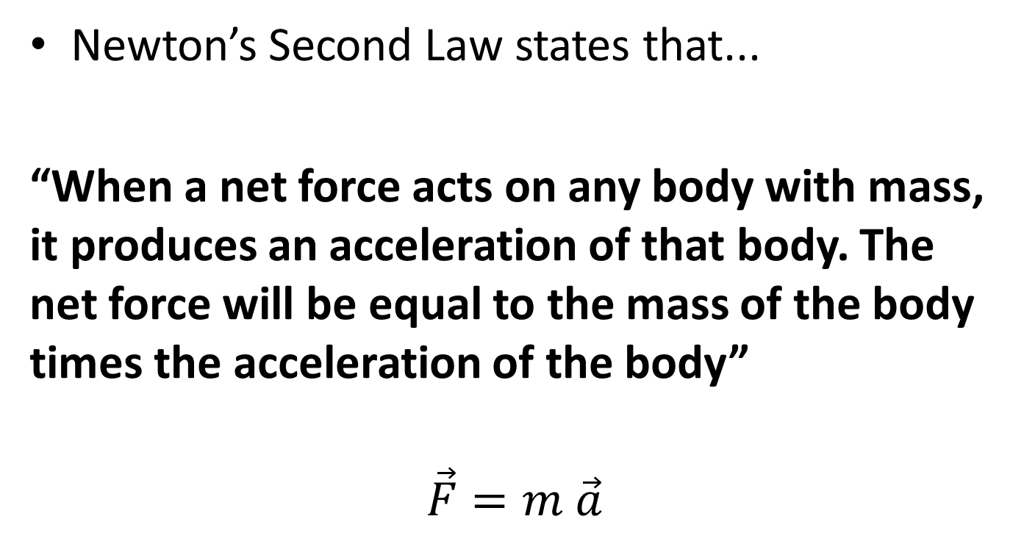
Newton’s Second Law
Newton’s Second Law states that...
“When a net force acts on any body with mass, it produces an acceleration of that body. The net force will be equal to the mass of the body times the acceleration of the body”
$$\vec{F}=m \vec{a}$$

Slide 3

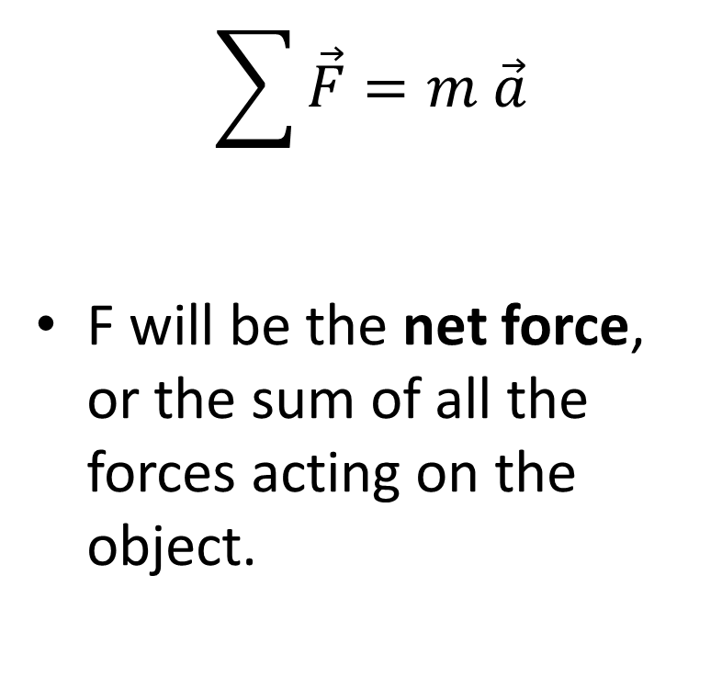
Newton’s Second Law
$$\sum{\vec{F}}=m \vec{a}$$
F will be the net force, or the sum of all the forces acting on the object.

Slide 4

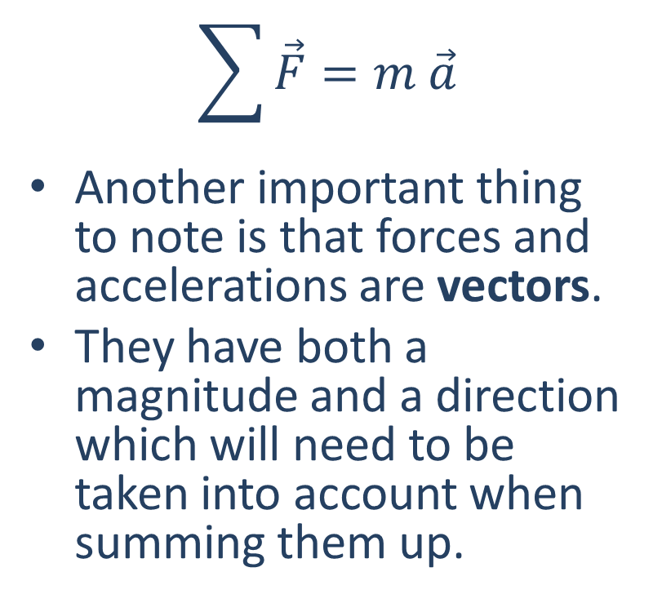
Newton’s Second Law
$$\sum{\vec{F}}=m \vec{a}$$
Another important thing to note is that forces and accelerations are vectors.
They have both a magnitude and a direction which will need to be taken into account when summing them up.

Slide 5

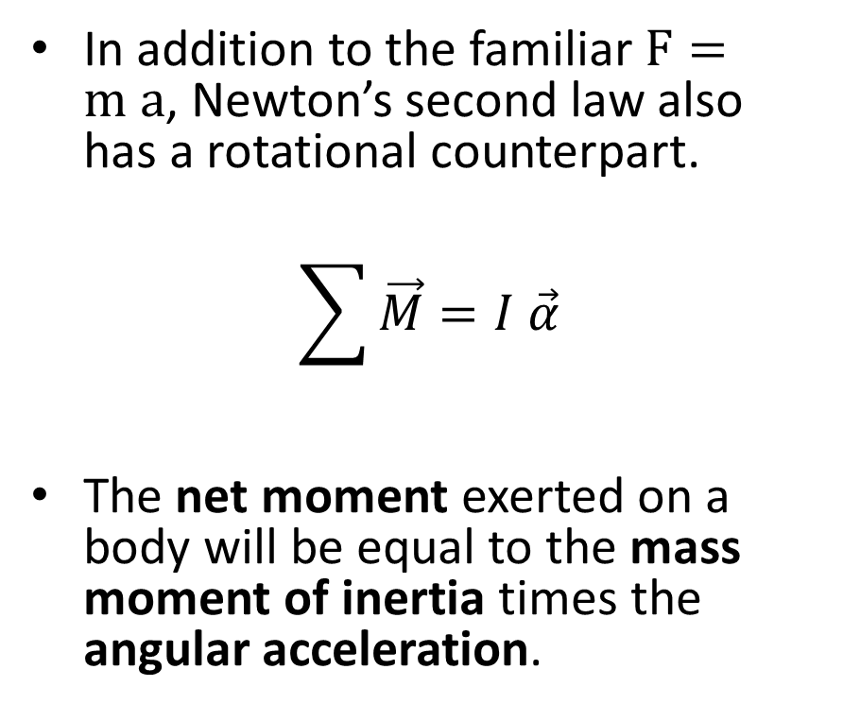
Newton’s Second Law (Rotation)
In addition to the familiar $F=m a$, Newton’s second law also has a rotational counterpart.
$$\sum{\vec{M}}=I \vec{α}$$
The net moment exerted on a body will be equal to the mass moment of inertia times the angular acceleration.

Slide 6
Thanks for Watching
See other engineering mechanics videos and access the full tool at…

